Slide 1
Pizza Sales Analysis by Harsh Bhandari
Dataset DescriptionTable Names:
order_details
Orders
Pizzas
pizza_types

Slide 2
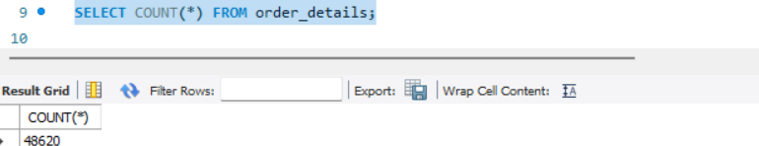
QUES 1 : Retrieve total number of order placed?
SELECT COUNT(*) FROM order_details;

Slide 3
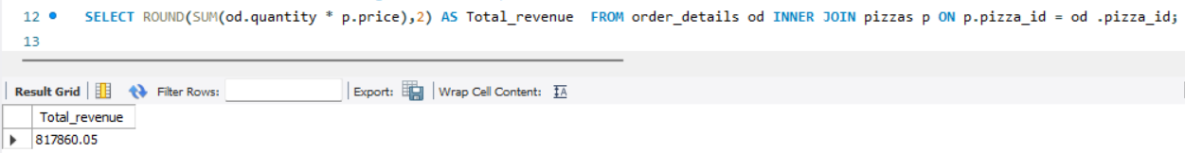
QUES 2 : Retrieve total revenue generated from pizza sales ?
SELECT ROUND(SUM(od.quantity * p.price),2) AS Total_revenue FROM order_details od INNER JOIN pizzas p ON p.pizza_id = od .pizza_id;

Slide 4
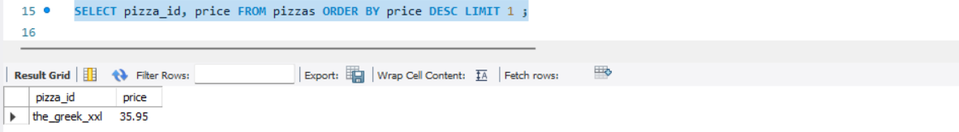
QUES 3 : Identify the highest priced pizza
SELECT pizza_id, price FROM pizzas ORDER BY price DESC LIMIT 1 ;

Slide 5
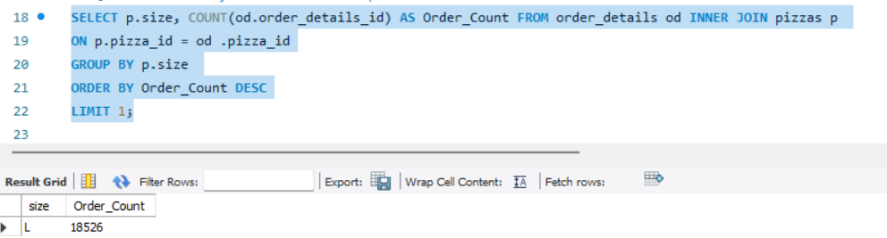
QUES 4 : Identify the most common pizza size ordered.
SELECT p.size, COUNT(od.order_details_id) AS Order_Count FROM order_details od INNER JOIN pizzas p ON p.pizza_id = od .pizza_idGROUP BY p.size ORDER BY Order_Count DESCLIMIT 1;

Slide 6
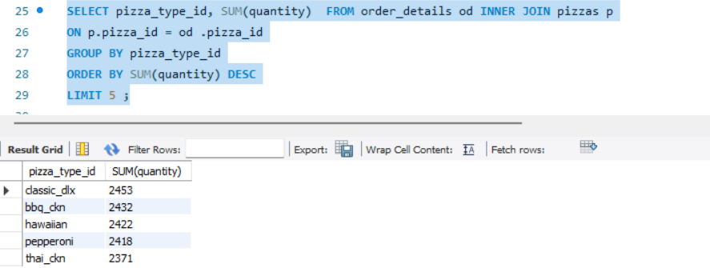
QUES 5 : LIST THE TOP 5 MOST ORDERED PIZZA TYPES ALONG WITH THERE QUANTITY
SELECT pizza_type_id, SUM(quantity) FROM order_details od INNER JOIN pizzas pON p.pizza_id = od .pizza_idGROUP BY pizza_type_idORDER BY SUM(quantity) DESCLIMIT 5 ;

Slide 7
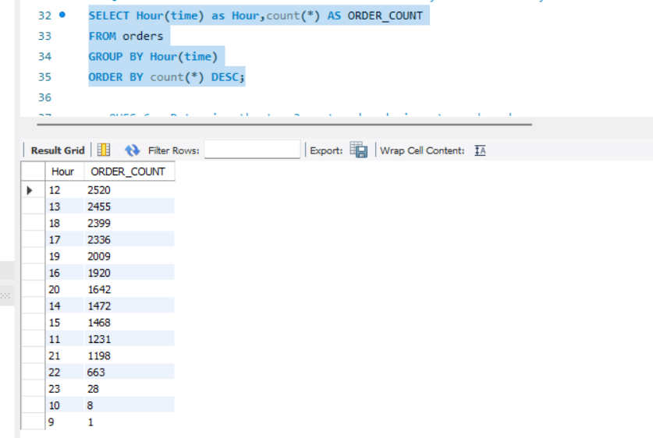
QUES 6 : Determine the distribution of orders by hour of the day
SELECT Hour(time) as Hour,count(*) AS ORDER_COUNTFROM ordersGROUP BY Hour(time)ORDER BY count(*) DESC;

Slide 8
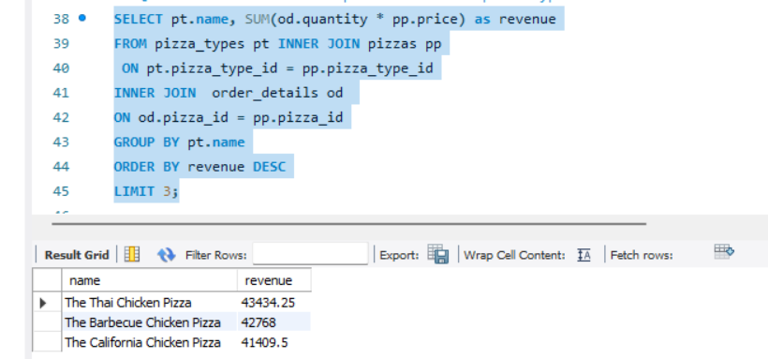
QUES 7 : Determine the top 3 most ordered pizza types based on revenue
SELECT pt.name, SUM(od.quantity * pp.price) as revenueFROM pizza_types pt INNER JOIN pizzas pp ON pt.pizza_type_id = pp.pizza_type_idINNER JOIN order_details od ON od.pizza_id = pp.pizza_idGROUP BY pt.nameORDER BY revenue DESCLIMIT 3;

Slide 9
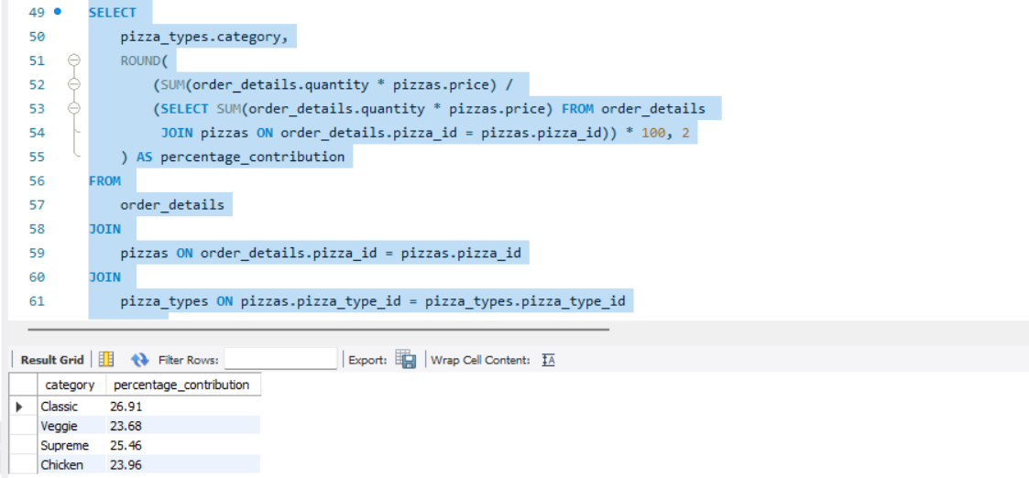
QUES 8 : Calculate the % contribution of each pizza category to the total revenue
SELECT pizza_types.category, ROUND( (SUM(order_details.quantity * pizzas.price) / (SELECT SUM(order_details.quantity * pizzas.price) FROM order_details JOIN pizzas ON order_details.pizza_id = pizzas.pizza_id)) * 100, 2 ) AS percentage_contributionFROM order_detailsJOIN pizzas ON order_details.pizza_id = pizzas.pizza_idJOIN pizza_types ON pizzas.pizza_type_id = pizza_types.pizza_type_idGROUP BY pizza_types.category;

